Slide 1
Make Your Content Talk
ReadSpeaker text-to-speech solutions give a voice to your learning management solutions.

Slide 2
Session Objectives
After this session, you will be able to:
Explain why students may want to use text-to-speech technology
Describe to your students how to use the ReadSpeaker Listen button within Moodle
Construct an effective plan to inform your students about the many uses of this text-to-speech technology within their learning environment.

Slide 3
ReadSpeaker Advantages (1)(Slide 1)
It can be accessed from any internet-connected device and browser
Seamless one-time implementation is done by adding a block to Moodle.
Read the HTML part of Moodle with webReader
Read Content documents with ReadSpeaker docReader.
Anytime you or an instructor change course content, the audio automatically and instantly reflects these changes.

Slide 4
ReadSpeaker Advantages (Slide 2)
Listen offline using the download to MP3 functionality if made available by the educational institution.
Enlarge Text, Text Mode, and the Page Mask all help distracted readers.
You can customize your settings, including font type, font size, background/text colors, text spacing, highlighting colors, etc.
The ReadSpeaker support team can assist with any questions or concerns during and after implementation.

Slide 5
Specific Benefits of Bimodal Content Presentation
Improved word recognition skills and vocabulary
Improved reading comprehension, fluency, accuracy, and concentration
Improved information recall and learning/memory enhancement
Increased motivation and a more positive attitude about reading
Increased reading self-confidence and perceived performance

Slide 6

How to Use ReadSpeaker Text to Speech (1)
How does it work?
To listen to the content on a page:
Click the listen button to hear the material read to you:
As you scroll down the page, the player will scroll with you. You can use the drag bar at the top to position the player where you want it on the page.

Slide 7
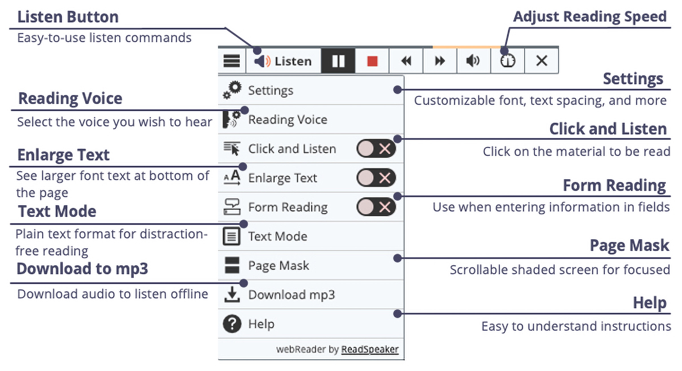
How to Use ReadSpeaker Text to Speech (2)
How does it work?
To listen to the content on a page:
The player expands, and you can use any of the tools:

Slide 8
How to Use ReadSpeaker Text to Speech (3)
Top Toolbar
Lower Toolbar
  Listen
  Pause/restart the reading
  Stop the reading
  Skip backward 5 seconds
  Skip forward 5 seconds
  Adjust the volume
  Reading Speed
  Close the player
  Customize your settings
  Change voices (if available)
  Click and Listen
  Enlarge Text
  Form Reading (needed in testing)
  Text Mode
  Page Mask
  Help
Note: When text is highlighted, Listen, Dictionary, and Translation appear on a pop-up.

Slide 9
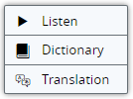
How to Use ReadSpeaker Text to Speech (4)
How does it work?
To listen to selected text:
You can select a part of the text to listen to, press the pop-up Listen button next to the mouse pointer, or click on Listen on the webReader player.
Pop-up commands:
webReader Player:

Slide 10


How to Use ReadSpeaker Text to Speech (5)
How does it work?
To listen to a document in Content using ReadSpeaker docReader:
Click on the icon, a sheet of paper with a speaker. ReadSpeaker docReader opens in a new window.
Click the ReadSpeaker docReader Listen button to listen to the selected page.

Slide 11

How to Use ReadSpeaker Text to Speech (6)
How does it work?
To listen to a document in Content using ReadSpeaker docReader:
Click the Expand toolbar to access the lower toolbar.
Click the ReadSpeaker docReader Help button for an extensive docReader user manual.

