Slide 1
Make Your Content Talk
ReadSpeaker text-to-speech solutions give a voice to your learning management solutions.

Slide 2
Session Objectives
After this session, you will be able to:
Explain why students may want to use text-to-speech technology
Describe to your students how to use the ReadSpeaker Listen button within Brightspace
Construct an effective plan to inform your students about the many uses of this text-to-speech technology within their learning environment.

Slide 3
ReadSpeaker Advantages (1)(Slide 1)
It can be accessed from any internet-connected device and browser
Seamless one-time implementation is done by adding an account number and asking D2L to turn it on.
D2L - Brightspace LMS for an easy, straightforward learner experience
Read HTML content in D2L Content, Quizzes, Assignments, and Discussion Topics & Threads with ReadSpeaker webReader
Read Content documents with ReadSpeaker docReader.

Slide 4
ReadSpeaker Advantages (Slide 2)
Read other areas in D2L, such as grades, rubrics, etc., with the ReadSpeaker TextAid Extension.
Ability to turn functionality on and off per course using Course Admin and Organizational Tools.
Anytime you or an instructor change course content, the audio automatically and instantly reflects these changes.

Slide 5
ReadSpeaker Advantages (Slide 3)
Listen offline using the download to mp3 functionality if made available by the educational institution.
Enlarge Text, Text Mode, and the Page Mask all help distracted readers.
You can customize your settings, including font type, font size, background/text colors, text spacing, and highlighting colors. You can also select the colors for your Page Mask focus and mask areas.
The ReadSpeaker support team can assist with any questions or concerns during and after implementation.

Slide 6
Specific Benefits of Bimodal Content Presentation
Improved word recognition skills and vocabulary
Improved reading comprehension, fluency, accuracy, and concentration
Improved information recall and learning/memory enhancement
Increased motivation and a more positive attitude about reading
Increased reading self-confidence and perceived performance

Slide 7
How to Use ReadSpeaker Text to Speech (1)
How does it work?
To listen to the content on a page:
Click the listen button to hear the material read to you:
As you scroll down the page, the player will scroll with you. You can use the drag bar at the top to position the player where you want it on the page.

Slide 8
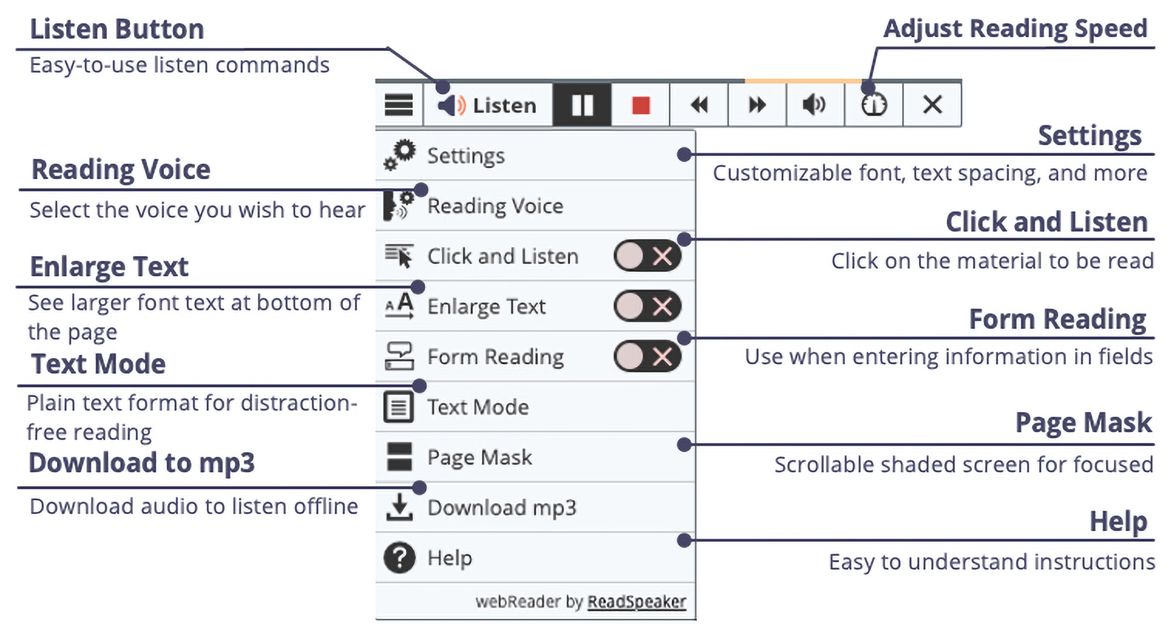
How to Use ReadSpeaker Text to Speech (2)
How does it work?
To listen to the content on a page:
The player expands, and you can use any of the tools:

Slide 9
How to Use ReadSpeaker Text to Speech (3)
Top Toolbar
Lower Toolbar
Listen
Pause/restart the reading
Stop the reading
Skip backward 5 seconds
Skip forward 5 seconds
Adjust the volume
Reading Speed
Close the player
Customize your settings
Change voices (if available)
Click and Listen
Enlarge Text
Text Mode
Page Mask
Help
Note: When text is highlighted, Listen, Dictionary, and Translation appear on a pop-up. Scrolling is on a Pop-up menu.

Slide 10
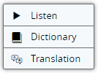
How to Use ReadSpeaker Text to Speech (4)
How does it work?
To listen to selected text:
You can select a part of the text to listen to, press the pop-up Listen button next to the mouse pointer, or click on Listen on the webReader player.
Pop-up commands:
webReader Player:

Slide 11
How to Use ReadSpeaker Text to Speech (5)
How does it work?
To listen to a document in Content using ReadSpeaker docReader:
Click on the “Open with docReader” link in the dropdown menu to the right of the name of the document and click on the “Open with docReader” button.
In the New Content Experience, click on the speaker on the right side of the screen. This opens docReader.
In the New Learner Experience, click on the headphones icon and the words “Open DocReader,” which opens docReader.

Slide 12
How to Use ReadSpeaker Text to Speech (6)
How does it work?
To listen to a document in Content using ReadSpeaker docReader:
Click the ReadSpeaker docReader Listen button to listen to the selected page.
Click the Expand toolbar to access the lower toolbar.
Click the ReadSpeaker docReader Help button for an extensive docReader user manual.

