Slide 1
Make Your Content Talk
ReadSpeaker text-to-speech solutions give a voice to your learning management solutions.

Slide 2
Session Objectives
After this session, you will be able to:
Explain why students may want to use text-to-speech technology
Describe to your students how to use the ReadSpeaker Listen button within the Blackboard Learn Ultra LMS
Construct an effective plan to inform your students about the many uses of this text-to-speech technology within their learning environment.

Slide 3
ReadSpeaker Advantages (Slide 1)
It can be accessed from any internet-connected device and browser
Seamless one-time implementation via an LTI into the Blackboard Learn Ultra LMS for an easy, straightforward learner experience
Reading of HTML areas of the Blackboard Learn Ultra LMS such as Content, Assignments, Quizzes, etc.
All documents automatically have ReadSpeaker docReader capability. Click on the “Open documents with docReader” link located on left-hand corner of the screen.

Slide 4
ReadSpeaker Advantages (Slide 3)
Listen offline by using the download to mp3 functionality if made available by the educational institution.
Text Mode and the Page Mask all help distracted readers.
Customize your settings, including font type, font size, background/text colors, spacing between characters, reading speed, paragraph highlighting color, etc.
The ReadSpeaker support team is available to assist with any questions or concerns during and after implementation.

Slide 5
Specific Benefits of Bimodal Content Presentation
Improved word recognition skills and vocabulary
Improved reading comprehension, fluency, accuracy, and concentration
Improved information recall and learning/memory enhancement
Increased motivation and a more positive attitude with regard to reading
Increased reading self-confidence and perceived performance

Slide 6

How to Use ReadSpeaker Text to Speech (1)
How does it work?
To listen to the content on a page:
Click the listen button to hear the material read to you:
As you scroll down the page, the player will scroll with you. You can use the drag bar at the top to position the player where you want it on the page.

Slide 7
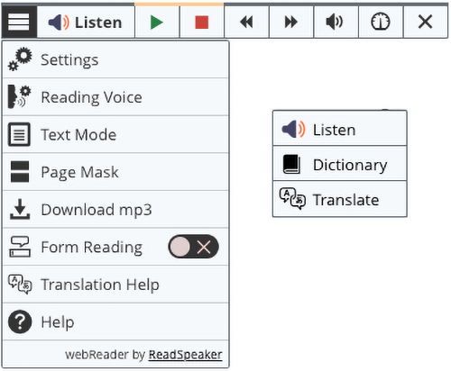
How to Use ReadSpeaker Text to Speech (2)
How does it work?
To listen to the content on a page:
The player expands, and you can use any of the tools:

Slide 8
How to Use ReadSpeaker Text to Speech (3)
Top Toolbar
Lower Toolbar
  Listen
  Pause/restart the reading
  Stop the reading
  Skip backward 5 seconds
  Skip forward 5 seconds
  Adjust the volume
  Reading Speed
  Close the player
  Customize your settings
  Change voices (if available)
  Text Mode
  Page Mask
  Download to MP3
  Form Reading
  Help
Note: When text is highlighted, Listen, Dictionary, and Translation appear on a pop-up. Scrolling is on a Pop-up menu.

Slide 9
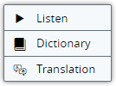
How to Use ReadSpeaker Text to Speech (4)
How does it work?
To listen to selected text:
You can select a part of the text to listen to, and then press the pop-up Listen button that appears next to the mouse pointer or click on Listen on the webReader player.
Pop-up commands:
webReader Player:

Slide 10
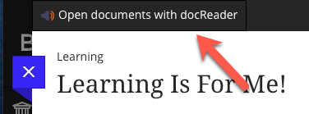
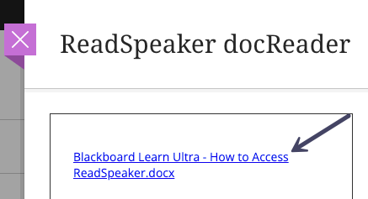
How to Use ReadSpeaker Text to Speech (5)
How does it work?
To listen to a document in Content using ReadSpeaker docReader:
Click the “Open documents with docReader” link on the top left of the screen.
Click on the document link in the right-hand side panel.

Slide 11

How to Use ReadSpeaker Text to Speech (6)
How does it work?
To listen to a document in Content using ReadSpeaker docReader:
Click the Expand toolbar to access the lower toolbar.
Click the ReadSpeaker docReader Help button for an extensive docReader user manual.

